Slide 1



Predictive Modeling for Credit Card Default Risk Assessment
Presented by:
Sai Sadhan Saravanan

Slide 2



BUSINESS PROPOSAL
Mitigate Credit Card Default Risk
Drive Sustainable Growth
Leverage ML Expertise

Slide 3





BUSINESS OUTCOMES
Risk Management Enhancement
Targeted Interventions for High-Risk Customers
Credit Policy Optimization
Customer Retention Strategies
Resource Allocation for Collections
Product and Service Development
Continuous Improvement

Slide 4


Data Exploration
Key findings of the Dataset
Number of Samples : 26664
Number of Columns : 31
Classification of data types :
11 Categorical, 14 Numerical
Age of the customers: 21 <= Age <= 79
Number of Duplicates & Null values : 0

Slide 5
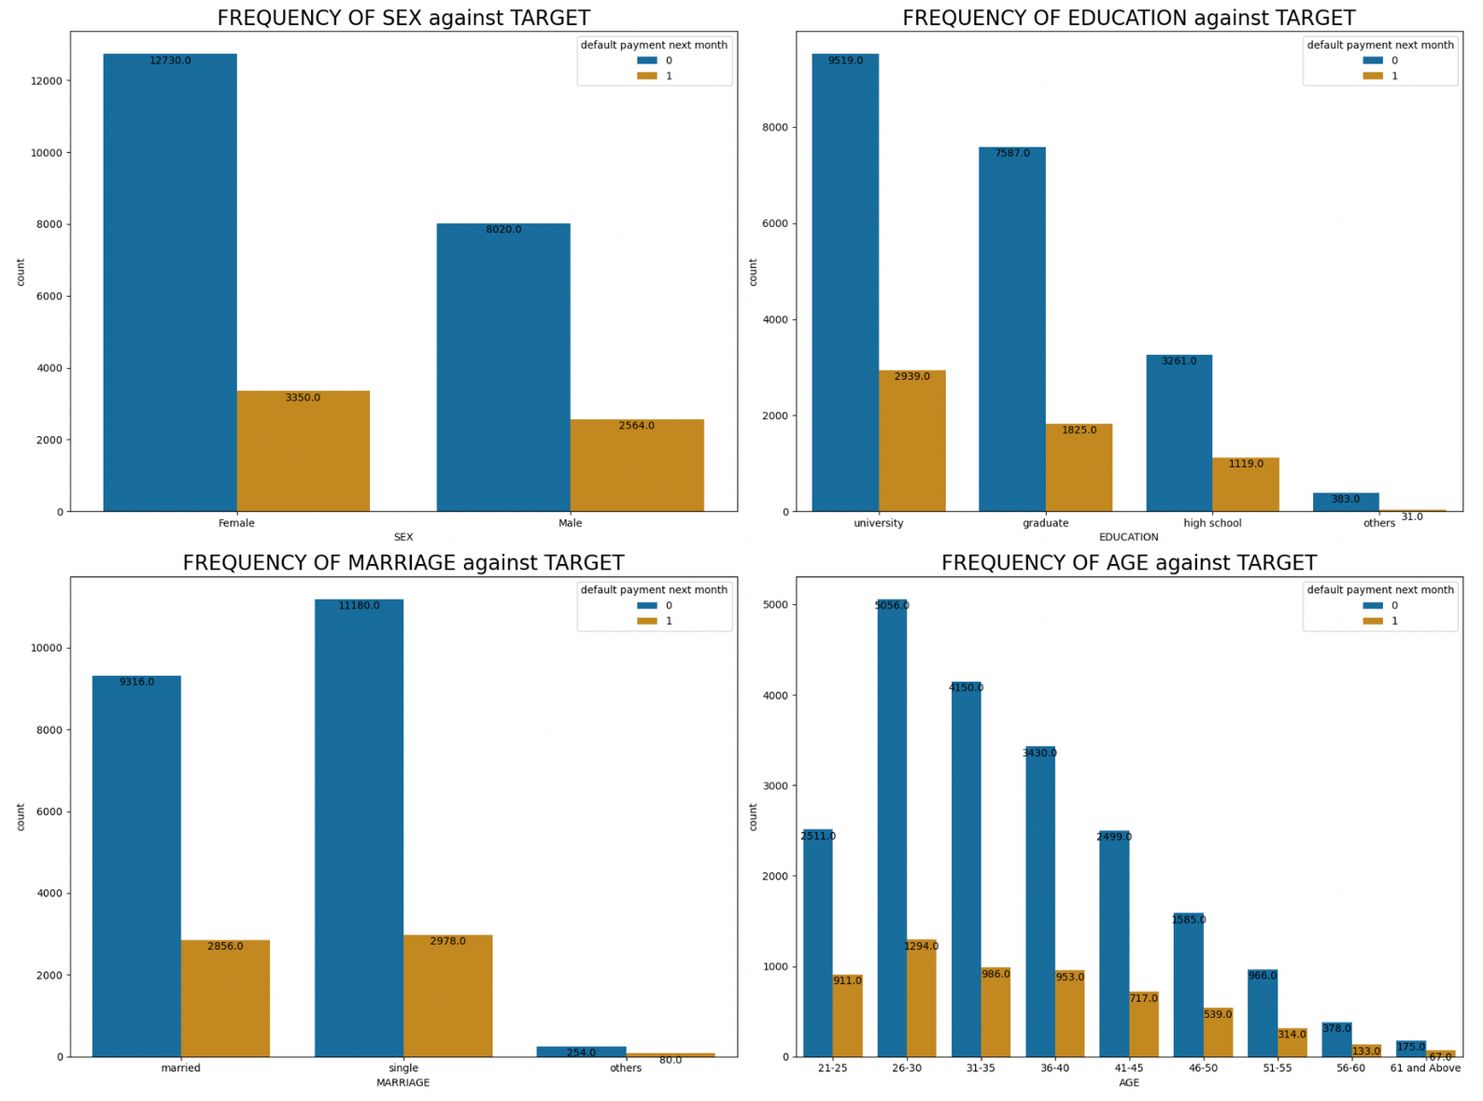
Distribution
of
Features

Slide 6

Data Cleaning
Handling missing values and duplicates if any
Dealing with outliers
Addressing inconsistencies in data formats
Encoding of Categorical variables :
SEX, EDUCATION, MARRIAGE, PAY_1, PAY_2, PAY_3, PAY_4, PAY_5, PAY_6
Dropping of irrelevant columns : ID, EDUCATION_CAT, graduate school, high school, none, others, university

Slide 7

Model Building
Splitting of Train & Test Data in 80:20 ratio
Employing of Predictive Machine Learning Algorithms
Decision tree
Logistic Regression
Bagging
Boosted model
Random Forest
Grid Search
Model training
Model evaluation metrics
Accuracy
AUC obtained from ROC
Precession & Recall

Slide 8
Model Comparison
Model | Accuracy | AUC
Boosted Model | 81.8% | 77.6%
Random Forest | 81.7% | 77.7%
Pruned Decision Tree | 81.3% | 73.5%
Decision Tree | 72.9% | 61.2%
Logistic Regression | 77.8% | 63.4%
Grid Search | 81.5% | 73.8%

Slide 9
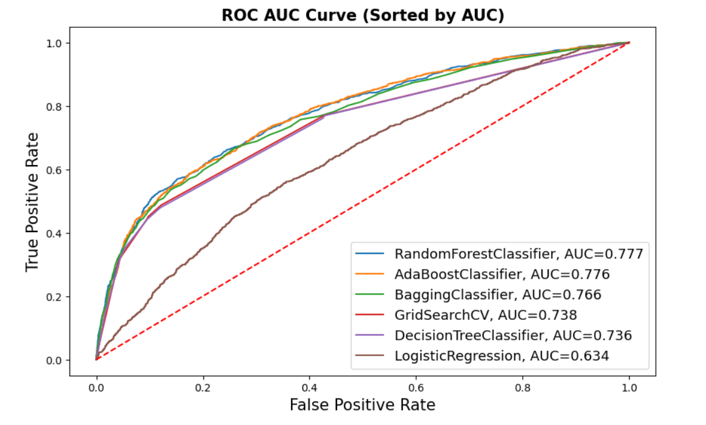
Visualization of ROC Comparison

Slide 10

Model Deployment Strategy
Integration Planning:
Define Requirements
Infrastructure Assessment
Model Deployment:
Development of API
Testing
Monitoring and Maintenance
Performance Monitoring
Feedback Loop
Ongoing Evaluation and Updates:
Regular Reviews
Model Retraining
Notes:
Integration Planning:
- Define Requirements: Collaborate with BestCard's IT and business teams to outline technical requirements, such as API endpoints, data input/output formats, and security considerations.
- Infrastructure Assessment: Evaluate BestCard's existing infrastructure to determine if additional resources are needed for model deployment, such as servers or cloud services.
3. Model Deployment:
- Development of API: Develop an application programming interface (API) that allows BestCard's systems to interact with the model for real-time predictions.
- Testing: Conduct thorough testing to ensure the model integrates well with BestCard's systems and performs accurately with live data.
4. Monitoring and Maintenance:
- Performance Monitoring: Set up monitoring tools to continuously assess the model's performance, checking for accuracy, speed, and reliability.
- Feedback Loop: Implement a feedback mechanism to collect data on the model's predictions and actual outcomes, allowing for ongoing model refinement.
5. Ongoing Evaluation and Updates:
- Regular Reviews: Schedule periodic reviews of the model's performance using the latest data, adjusting for shifts in customer behavior or economic conditions.
- Model Retraining: Use new data and insights from the ongoing evaluation to retrain the model, ensuring it remains accurate over time.
6. Stakeholder Engagement:
- Training Sessions: Offer training sessions for BestCard staff to understand the model's functionality, its use in decision-making, and how to interpret its predictions.
- Reporting: Provide regular reports to BestCard's management on the model's performance, including its impact on predicting defaults and decision-making processes.

Slide 11






BUSINESS SUGGESTION
Early Intervention Strategies
Customized Communication
Credit Limit Adjustments
Financial Literacy Programs
Integration with Customer Service
Notes:
Early Intervention Strategies: Use model predictions to identify high-risk account holders early and proactively engage with them through counseling, payment reminders, or restructuring their debt to prevent defaults.
Customized Communication: Tailor communication and intervention strategies based on the risk profile and characteristics of the account holder, which could increase the effectiveness of such interventions.
Credit Limit Adjustments: For account holders identified as high risk, consider adjusting credit limits or terms to mitigate potential losses. Conversely, for those with low risk, consider credit limit increases to encourage spending and loyalty, provided it's done responsibly.
Financial Literacy Programs: Implement educational programs targeting account holders with characteristics associated with higher default rates. These programs can cover budgeting, financial planning, and the implications of defaulting.
Continuous Model Monitoring and Updating: Economic conditions, consumer behavior, and credit policies evolve, so it's crucial to regularly update the models with new data and monitor their performance to ensure they remain accurate and relevant.
Integration with Customer Service: Use model insights to inform customer service practices, such as identifying when an account holder might benefit from speaking with a financial advisor.

Slide 12

CONCLUSION
Comprehensive analysis of credit card dataset:
Unveiled valuable insights into customer behavior and credit risk.
Successful model competition:
AdaBooster emerged as the leading model.
Paves the path for innovative risk management strategies.
Future prospects:
Embracing data-driven decision-making in finance.
Opportunities for implementing advanced risk management techniques.
Notes:
In conclusion, our comprehensive analysis of the credit card dataset has unveiled valuable insights into customer behavior and credit risk. The successful model competition, with AdaBooster leading the way, paves the path for innovative risk management strategies and a future of data-driven decision-making in finance.

Slide 13


THANK YOU
Let us know if you have any questions!

